Slide 1



Start your search
Get started
Notes:
#Steven

Slide 2

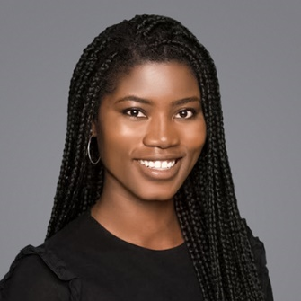
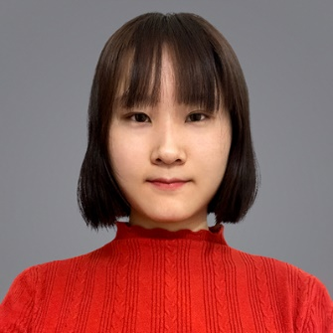

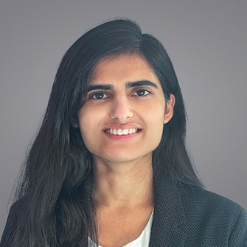
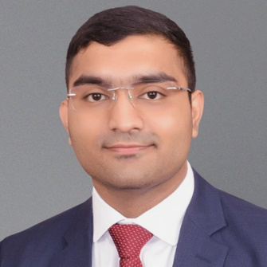

Our Team
Eunice Worifah
Fandi Yi
Pascal Nguyen Tang
Shivangi Soni
Vivek Saahil
Data Scientist
Data Scientist
Product Manager
Data Analyst
Business Analyst
euniceworifah Bubbletea98 pnguyentangmcgill shivangi-soni vsaahil

Slide 3
Business Context
Abc
…
…
…

Slide 4
Approach
Make a flowchart with the outline of all the stuff we have done till now

Slide 5
Models and Results
Delve a bit deeper into each model and their results

Slide 6
Threats to Validity
…

Slide 7
Explainability & Feature Importance – Best Model
…

Slide 8
Insights and Business Implications
…

Slide 9
Lessons learnt & Next steps
…

Slide 10

Thank You

Slide 11
Appendix
…

